Slide 1
SPAZE DAZE
by Joseph and Igor

Slide 2


About Us

Slide 3
Igor Zelenov
Country: Ukraine, Odessa
Spaze Daze High Score: 42
Handsome
Innovative
Hobby: Soccer

Slide 4

Joseph I. Vega
Country: USA, Miami FL
Spaze Daze High Score: 41
Handsome
Creative
Hobby: Reading

Slide 5
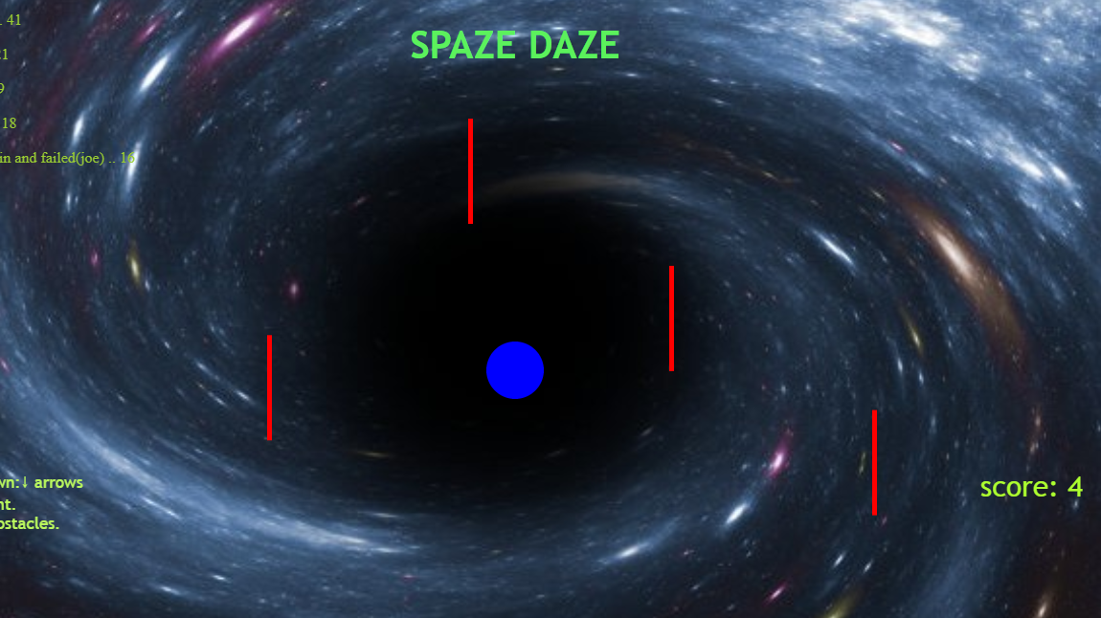
Our Project
Name: SPAZE DAZE
Genre: Arcade, Single-Player
Code: Canvas JS
Idea Origin: Flappy
Bird + Space
Result: Something cooler

Slide 6
How it works
Objective: evade the red
obstacles
Press up to go up
Press down to go down
Score + 1 every 2 seconds

Slide 7
Biggest Technical Issue
Issue: Scoreboard/upload
The scoreboard would crash
the game online
Solution: Re-worded the
scoreboard logic.

Slide 8
Demo
https://josephvisaac.github.io/1st-Project-2d-game/index.html

Slide 9
The End
Joseph Vega, Igor Zelenov, Spaze Daze, Thank You

